Slide 1
P2P E-Learning Platform using Cloud Computing
Submitted in the partial fulfillment for the award of the degree of
BACHELOR OF ENGINEERING
IN
Computer Science
Submitted by:
Name | UID
Aadarsh Nagrath | 21BCS5730
Priyanshu Srivastava | 21BCS6911
Anurag Kumar | 21BCS6940
Akshat Choudhary | 22BCC80003
Under the Supervision of:
Prof .Vikas Kumar
DISCOVER . LEARN . EMPOWER
Department of AIT-CSE

Slide 2

Outline
Introduction to Project
What is P2P LMS
Problem Formulation
Objectives of the work
Methodology used
Results and Outputs
Conclusion
Future Scope
References

Slide 3

Introduction to Project
What is an E-Learning Platform ?
It is a platform
That delivers educational content online
That provides a virtual learning environment
That is flexible, scalable, cost-effective , and can be accessed from anywhere using internet.

Slide 4





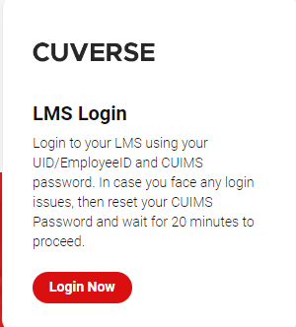
Examples of many existing E-learning Platforms

Slide 5
What is P2P LMS
P2P LMS stands for Peer-to-Peer Learning Management System. It is a type of online learning management system that facilitates learning through interactions between learners, without relying solely on an instructor or central authority.
Here you can create course and be a instructor as well as be a student and consume course content.
Example of a rough idea – Imagine having a e-learning platform , focused on CU students and learners. Here each and every student from college seniors to juniors can share there knowledge by creating courses. Discussing problems and doubts in discussion forums and improving their skills.

Slide 6
Problem Formulation
Access to quality education is a fundamental right, yet millions of people in rural areas around the world lack access to adequate educational resources.
The lack of adequate educational resources in rural areas has serious implications for social and economic development, as it limits the ability of individuals and communities to acquire the skills and knowledge necessary to thrive in today's globalized world.
To address this problem, there is a need for an e-learning platform that is designed specifically for rural areas and overcomes the limitations of traditional e-learning platforms.
The proposed solution is to develop an e-learning platform using cloud computing and P2P networking, which can provide a scalable, cost-effective, and low-latency solution for delivering education to rural areas.
Additionally, the use of cloud computing will enable the platform to be scalable and cost-effective, by allowing for on-demand allocation of computing resources and storage.

Slide 7
Objectives of the Work
Building e-learning website with admin and user logins with their respective managing consoles and features.
Deploying the platform to cloud to ensure its accessibility.
Offering flexibility in terms of content delivery allowing instructors and administrators to provide best learning experience to meet the needs of learners.
Overall, creating an e-learning website using cloud computing can help improve the quality of education
Making it P2P and community based focused learning platform.

Slide 8
Methodology
Needs Assessment: The first step is to identify the needs of the target audience and determine the learning objectives.
Platform Selection : Deciding on cloud platform to use.
Tech Stack Selection: Choosing programming languages and technologies as per need.
Building website - This is major step involving construction of front end , backend , API connections and other building operations.
Testing and debugging website

Slide 9
Content Development: With the platform in place, the next step is to develop the learning content, including multimedia materials such as videos, images.
Integration: The learning content is then integrated into the e-learning platform, along with any other necessary tools and resources, such as assessments, Quizzes.
Deployment: Once the e-learning website has been developed, it is deployed on the cloud infrastructure, making it accessible to learners from anywhere with an internet connection.
Monitoring and Evaluation: Finally, the e-learning website is monitored and evaluated to ensure that it is meeting the learning objectives and the needs of the target audience. This involves tracking user engagement, analyzing user feedback, and making any necessary adjustments to improve the learning experience.
Feedback loop and improvement iteration

Slide 10
Features
User-friendly interface
Admin console and User Console
Courses – Video , pdf, doc, Quizs, Resources ,Attachments, Course Manager panel
Payment Gateway – Stripe & Paypal
Login Authentication
Responsiveness

Slide 11
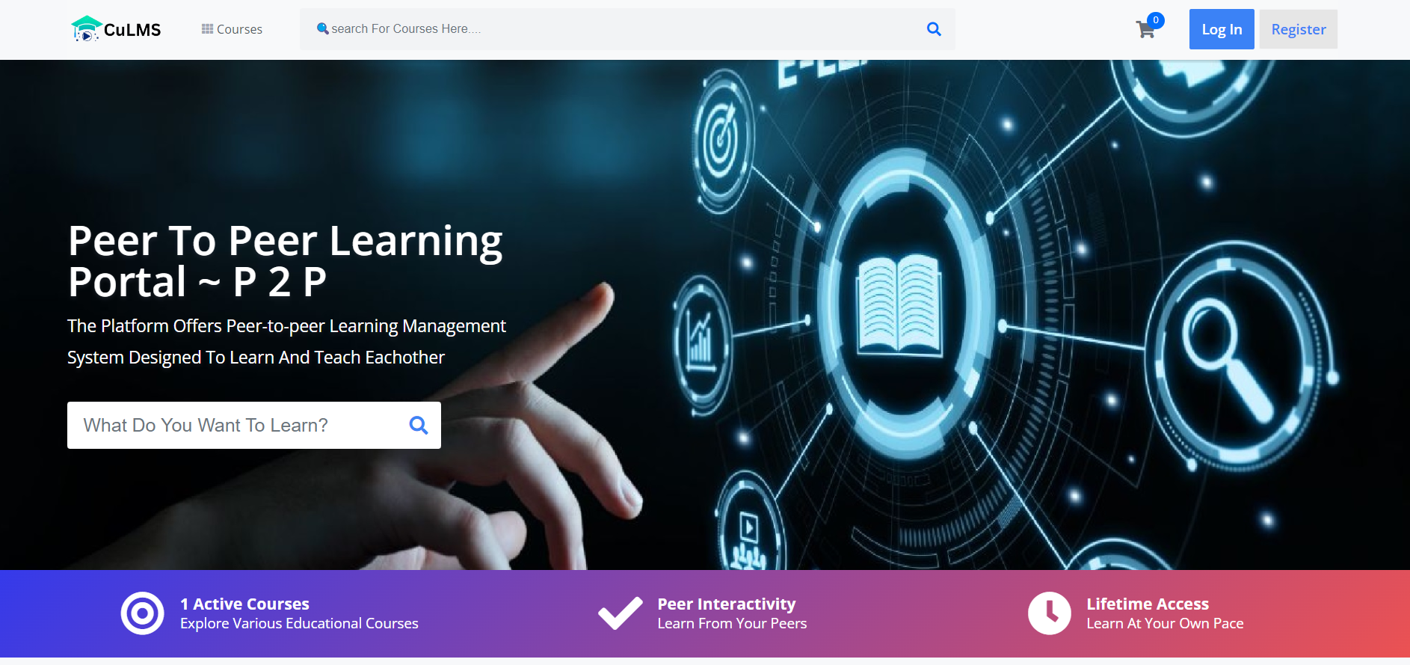
Result & Output
Home Page

Slide 12

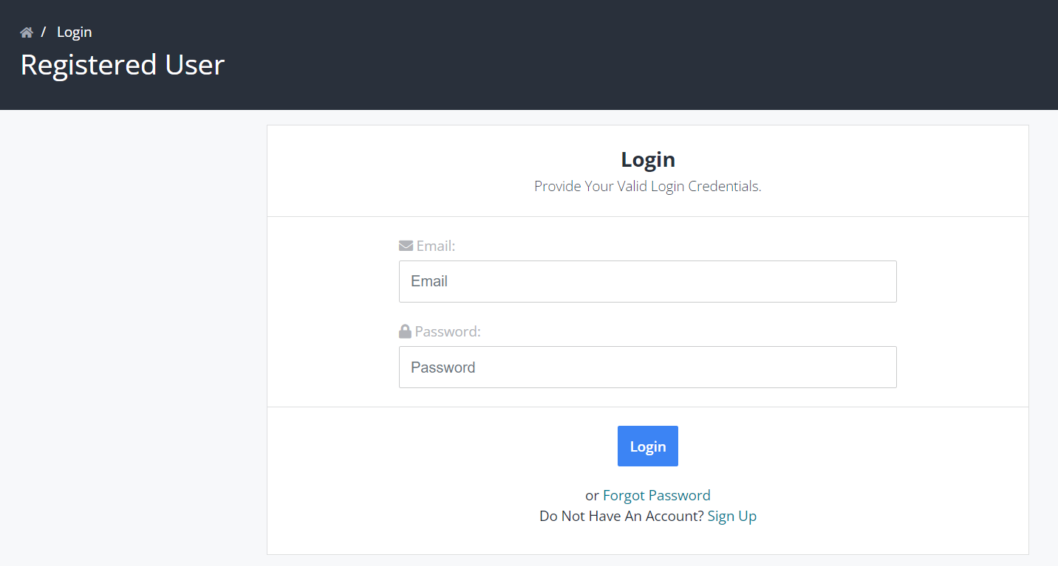
Login and Register Page

Slide 13
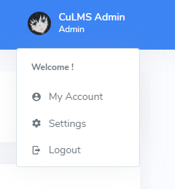
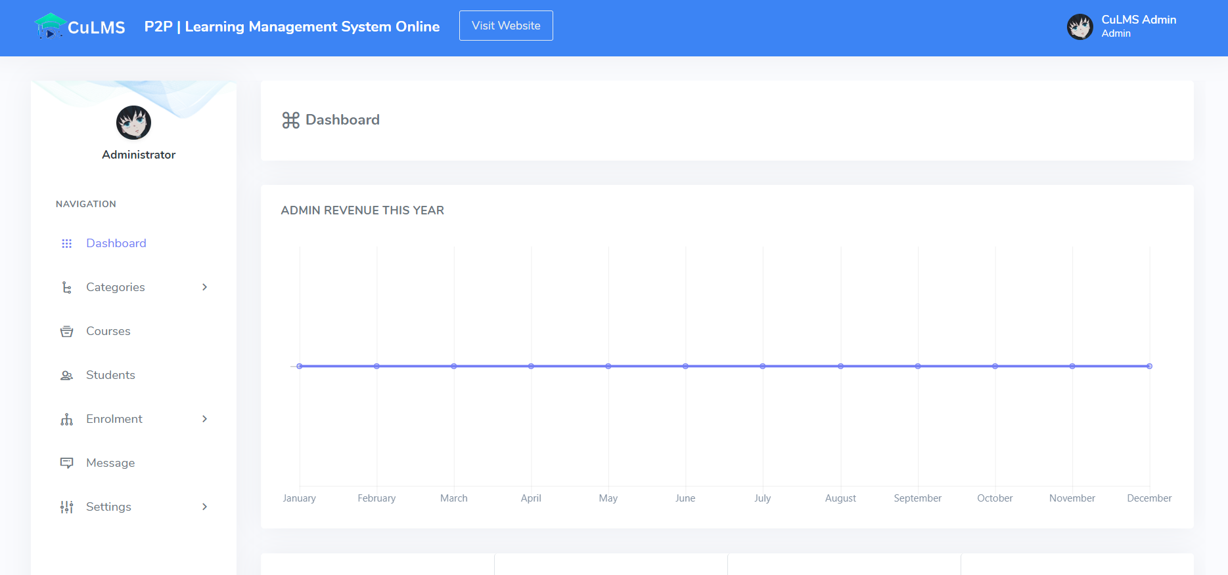

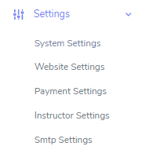
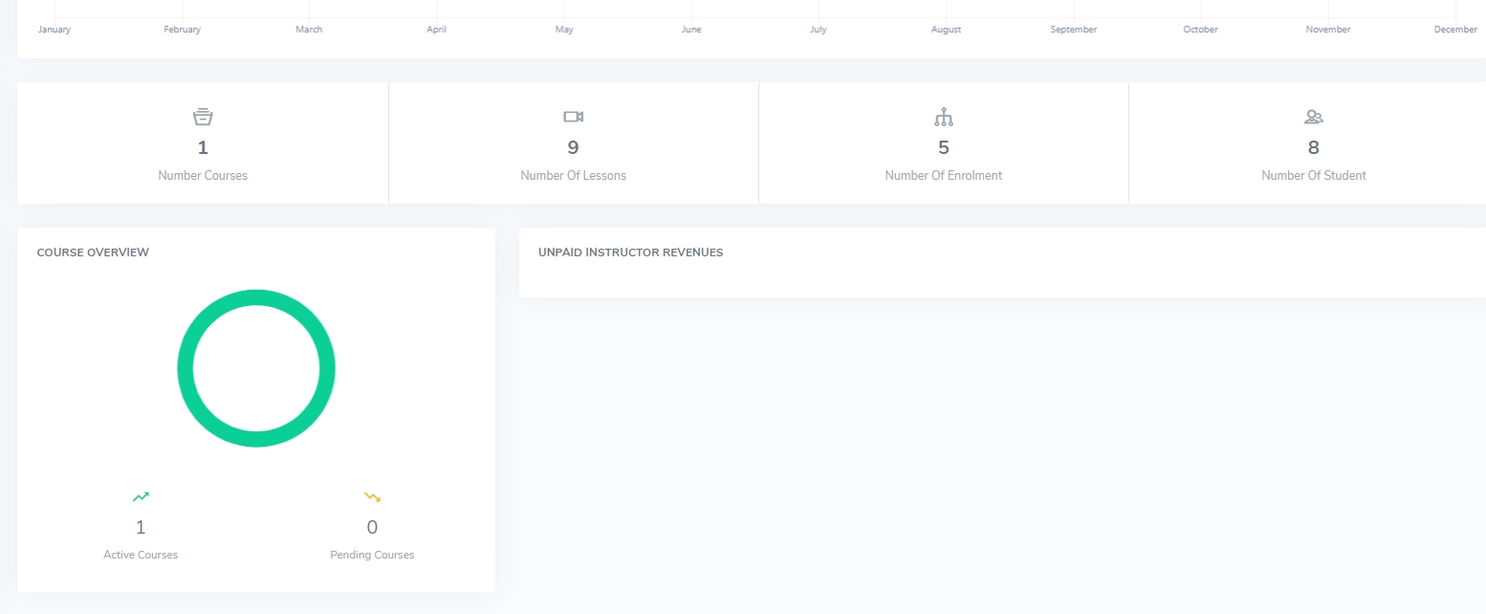
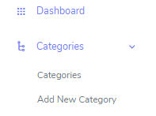
Admin Panel / Dashboard

Slide 14
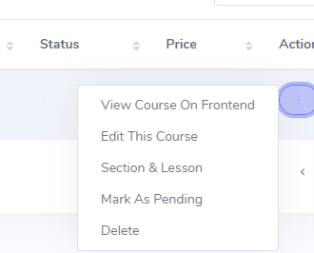
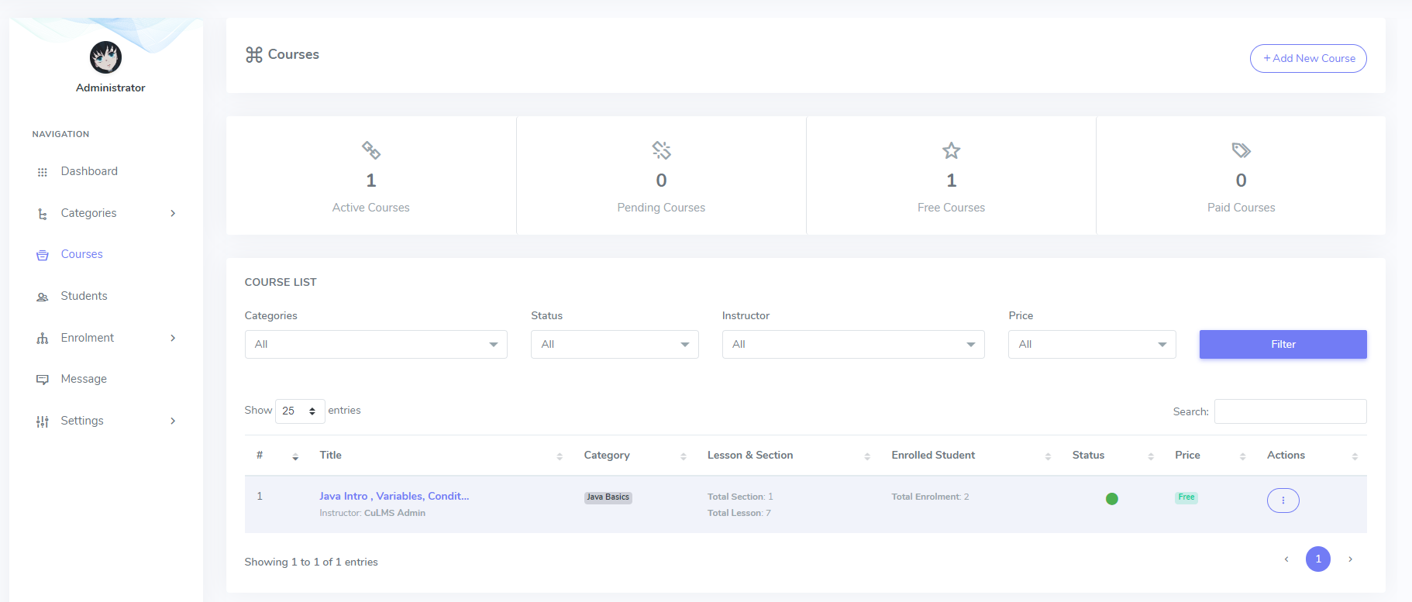
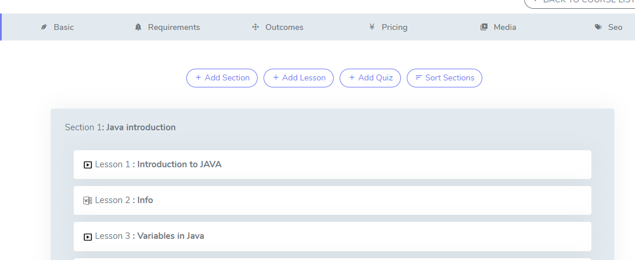
Course Panel
Course Creation

Slide 15
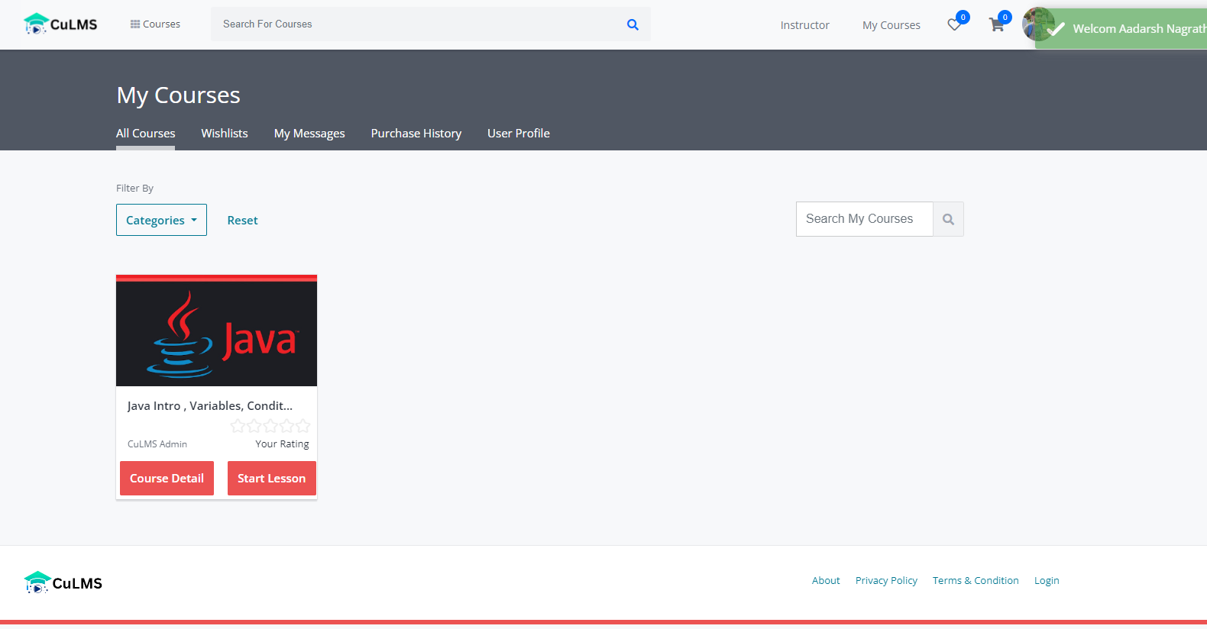
User panel / Dashboard
Courses

Slide 16
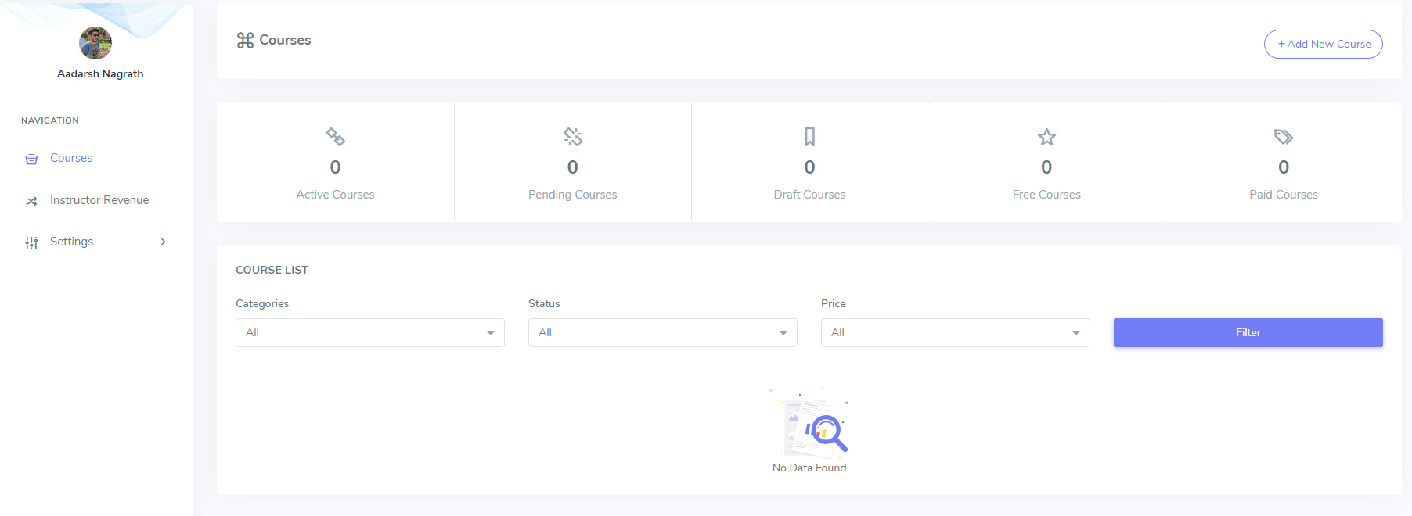
Instructor Panel in User Dashboard

Slide 17
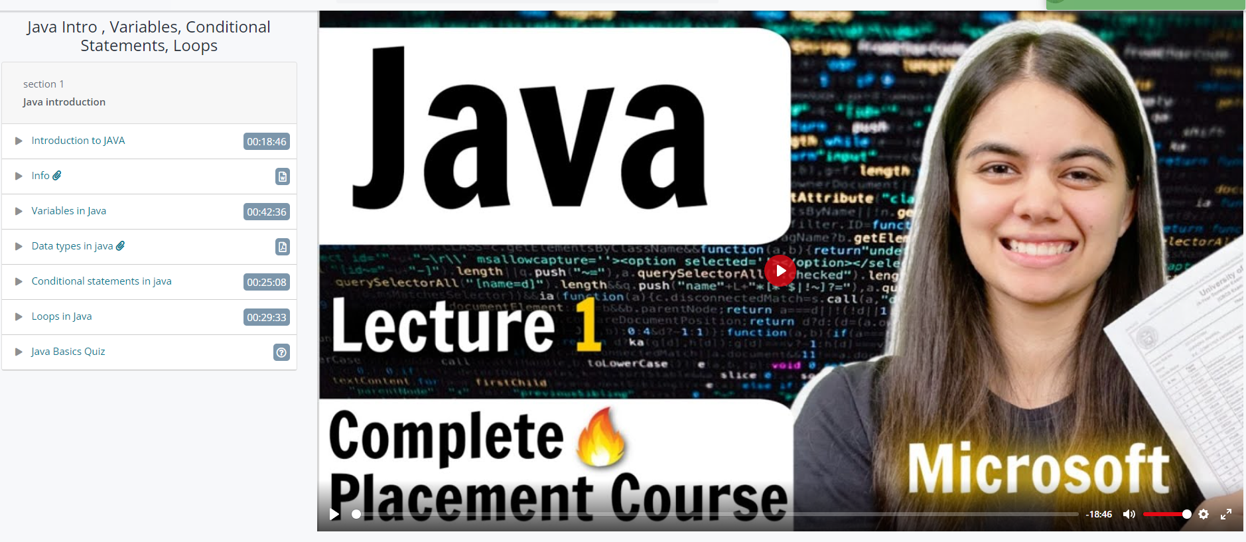
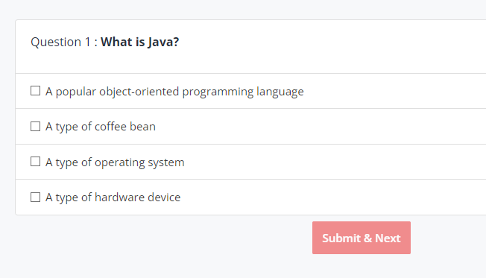
Course Interface
QUIZES

Slide 18

Conclusion
E-learning platforms using cloud computing provide numerous benefits for learners and educators.
Cloud computing infrastructure is scalable, accessible, reliable and cost-effective for hosting e-learning applications.
Courses and learning material on e-learning platforms will provide engaging and interactive experience.
This approach has the potential to revolutionize the way we learn and acquire knowledge.
P2P and community based learning experience.

Slide 19
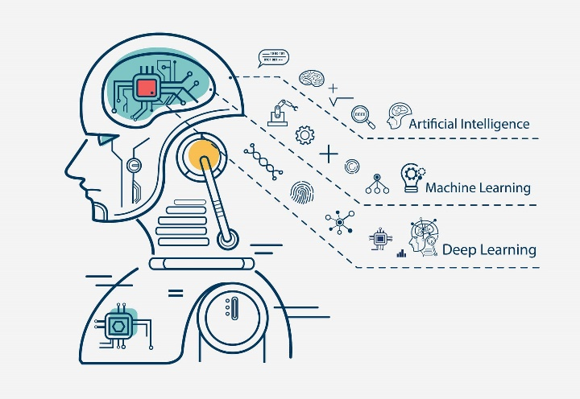


Future Scope
AI-powered Learning
video – conferencing
other features in websites such as discussion groups, community learning
etc

Slide 20
References
[1] Hou, L., Liu, Q., Nebhen, J., Uddin, M., & Chaudhary, A. (2022). Implementation of Cloud Computing Protocol in E-Learning for Future Wireless Systems.
[2] Dima, A., Bugheanu, A.-M., Boghian, R., & Madsen, D. Ø. (2019). Mapping Knowledge Area Analysis in E-Learning Systems Based on Cloud Computing.
[3] P. Hendradi, M. Khanapi, and S. N. Mahfuzah, "Cloud Computing-Based E-Learning System Architecture in Education 4.0," International Journal of Emerging Technologies in Learning (iJET), vol. 15, no. 17, pp. 137-154, 2020.
[4] Rinkey, Dr. Piyush Gupta, and Dr. Archana Bhatnagar, "Implementation of Cloud based E-learning Architecture," BIT Jaipur, India, 2022.
[5] Kumar, V., & Sharma, D. (2019). E-Learning Theories, Components, and Cloud Computing-Based Learning Platforms.
[6] Wu, W. & Plakhtii, A. (2021). E-Learning Based on Cloud Computing.
[7] Katiyar, N., & Bhujade, R. (2019). E-Learning System based on Cloud Computing: A Review Paper.
[8] "E-learning platform using cloud computing: A systematic literature review" by Amany Saleh, Ayman Ezzat, and Mohammad Alshayeb, published in Education and Information Technologies (2019).

Slide 21
[9]"Cloud Computing in E-Learning: A Review of Literature" by Sheikh Shuja Ahmed, Mohammad Tariq Banday, and Ghulam Mohiuddin Wani, published in International Journal of Engineering Science and Computing (2018).
[10]"Design and Implementation of Cloud-Based E-Learning Platform" by Qing Li and Jianbin Hu, published in International Journal of Emerging Technologies in Learning (2016).
[11] "Cloud Computing for E-Learning: A Review of the Literature" by Gulsah Koc and Goksel Yalcinkaya, published in International Journal of Advanced Computer Science and Applications (2014).
[12] "A Study on Cloud Computing-Based E-Learning System" by Shu-Chen Hsu, Chun-Wei Huang, and Chien-Hung Liu, published in the Journal of Educational Technology & Society (2014).
[13]"A Model for Cloud Computing Based E-Learning System" by Siti Nurmaini, Siti Zaiton Mohd Hashim, and Aziz Deraman, published in the Journal of Theoretical and Applied Information Technology (2015).
[14]"Cloud Computing-Based E-Learning Platform Using Open Source Software" by Fazal-e-Amin, Muhammad Hamad Alizai, and Irfan Ullah, published in the Journal of Cloud Computing: Advances, Systems and Applications (2019).
[15] "Cloud-Based E-Learning Platform for Higher Education Institutions" by Harikrishnan M and M. V. Rajesh, published in International Journal of Emerging Technologies in Learning (2018).

Slide 22
Thank You

